Slide 1
SIWES TECHNICAL REPORT
By: ADRIAN ROCA MOCHE

Slide 2
STUDENT INDUSTRIAL WORK EXPERIENCE SCHEME
(S.I.W.E.S)
REPORT
CARRIED OUT AT
START INNOVATION HUB GROUND FLOOR, ROOM 11, E-LIBRARY, UYO , AKWA IBOM STATE.
PRESENTED
BY
ADRIAN ROCA MOCHE
U1CS1702DE

Slide 3
HIGHLIGHTS
About START INNOVATION HUB
My Work Experiences
About Web Development
About HTML and CSS
About Javascript
About CSS and Javascript frameworks
My First WebPages
Conclusion

Slide 4
SKILLS ACQUIRED
Deep knowledge on front-end web development
Ability to create a websites using HTML, CSS and Javascript
Ability to debug errors and being creative in arrangement codes
How to use CSS frameworks and Javascript frameworks in building a responsive websites
Installing several developmental tools like VS codes, Dreamweaver, and Atom, knowing how to use them effectively.
Learning how to work with designed templates and creating templates
Ability to work in a team with live projects

Slide 5
ABOUT HTML
HTML stands for Hypertext Mark-up Language, and it is the most widely used language to write Web Pages.
Hypertext refers to the way in which Web pages (HTML documents) are linked together. Thus, the link available on a webpage is called Hypertext.
As its name suggests, HTML is a Markup Language which means you use HTML to simply "mark-up" a text document with tags that tell a Web browser how to structure it to display.
Originally, HTML was developed with the intent of defining the structure of documents like headings, paragraphs, lists, and so forth to facilitate the sharing of scientific information between researchers.
Now, HTML is being widely used to format web pages with the help of different tags available in HTML language.

Slide 6
ABOUT CSS
CSS stands for Cascading Style Sheet used for formatting html document. It is a style sheet language used for describing the presentation of a document written in a mark-up language.
Note: CSS code is not written the same way as HTML code is. This makes sense because css is not HTML, but rather a way of manipulating existing HTML.
There are different ways to style a website either with external css or internal css.
also CSS comes with different frameworks like BOOTSTRAP mostly used by developers today, we also got BULMA and so on.

Slide 7
Reasons for css
It saves time
It eradicate the idea of using repeating codes
It provides efficiency in design and updates: with css, we are able to create rules, and apply those rules to many elements within the website.
It can lead to faster page downloads

Slide 8
ABOUT JAVASCRIPT
JavaScript is a dynamic computer programming language. It is lightweight and most commonly used as a part of web pages, whose implementations allows client side script to interact with the user and make dynamic pages. It is an interpreted programming language with object oriented capabilities. It was developed by Brenan Eich 1995-1996; it is an implementation of ECMA Script (European Computer Manufacturers Association). It was also known as livescript later change to javascript. It is use for client side web form validation. Javascript cannot run with been embedded in the HTML.

Slide 9
Function of javascript
It is most commonly used as a client side scripting language, which implies that javascript is written into an HTML page and when a user request an HTML page with javascript in it, the script is sent to the browser.
It used for form validation.
It make the web page functional.

Slide 10

Jayschool.netlify.com

Slide 11


Jaytech-hub.netlify.com
Product A
Product B

Slide 12
The use of git and github
Git is an open-source version control system that was started by Linus Trovalds—the same person who created Linux.
So, Github is a version control system.
It can be used to stored any sort of file or data. It is mostly used by web developers, but git not for only developers, any can use github to stored various file there like a cloud by creating a repository.
A repository (usually abbreviated to “repo”) is a location where all the files for a particular project are stored. Each project has its own repo, and you can access it with a unique URL.

Slide 13
CONCLUSION
The Student Industrial work Experience Scheme (SIWES) gave me the privilege to relate with senior professionals and other students from different institutions. The knowledge acquired is not only academic or technical as I was also made to understand the importance of other fields of study and ultimately appreciate the roles they play to the success of any industry. The experience made me appreciate my chosen field of study both in the classroom and in the larger society.

Slide 14
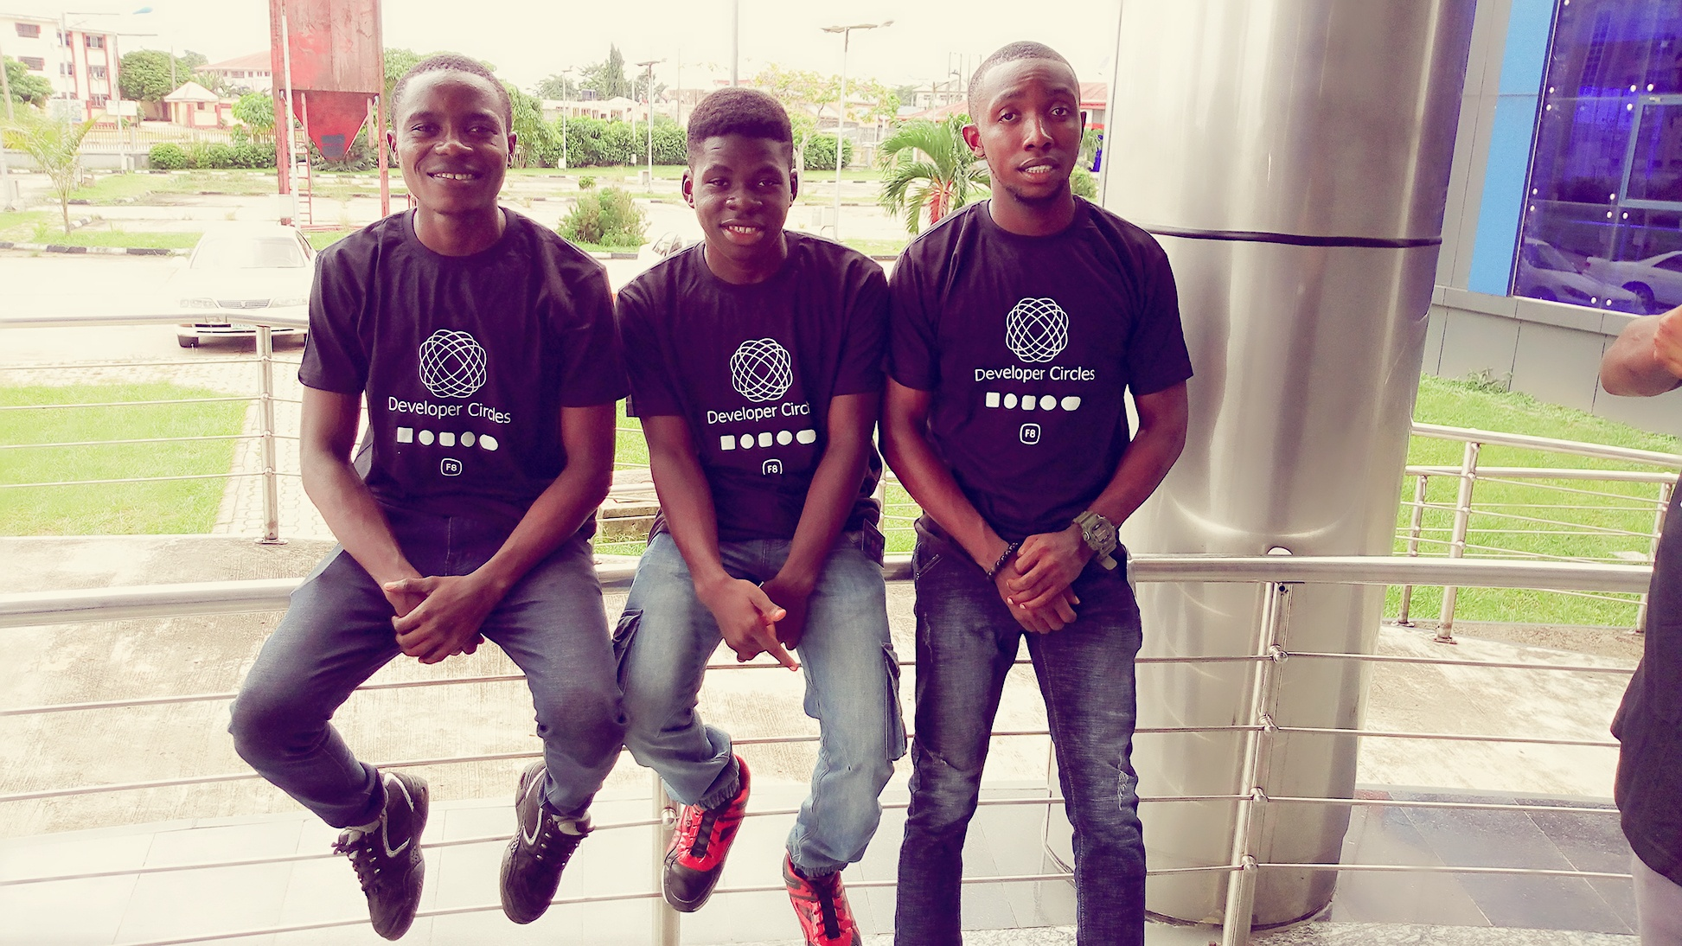

Slide 15
ANY QUESTIONS?

